Slide 1
Green's Functions

Slide 2



Introduction
Green's functions are named in honor of english mathematician and physicist george green (1793-1841).
His father was a baker who had built and owned a brick windmill used to grind grain.
George green was the first person to create a mathematical theory of electricity and magnetism.
His theory formed the foundation for the work of other scientists such as James Clerk Maxwell, William Thomson, and others.
His work ran parallel to that of the great mathematician gauss (potential theory).
What is the Green's function?
  Green's function is a type of function used to solve inhomogeneous differential equations subject to boundary conditions.
  Green's function is used in quantum field theory, electrodynamics and statistical field theory.
  For heat conduction, Green's function is proportional to the temperature caused by a concentrated energy source.
  The exact form of the Green's function depends on the differential equation, the body shape, and the type of boundary conditions present.

Slide 3
Introduction
Books on Green's Functions:
Heat Conduction using Green's Functions, K. D. Cole, J. V. Beck, A. Haji-Sheikh, and B. Litkouhi, Second Edition, CRC Taylor and Francis, New York, 2011.
Elements of Green's Functions and Propagation, G. Barton, Oxford, UK, 1989.
Green's Functions in Applied Mechanics, Y. Melnikov, Computational Mechanics Publications, Boston-Southhampton, 1995.
Green's Functions with Applications, D. G. Duffy, Chapman and Hall/CRC Press, Boca Raton, Florida, 2001.
Diffusion-Wave Fields: Mathematical Methods and Green Functions, A. Mandelis, Springer-Verlag, New York, 2001.
  Books on Heat Conduction:
    Conduction of Heat in Solids, H. S. Carslaw and J. C. Jaeger, 2nd Ed, Oxford, 1959.
    Analytical Heat Diffusion Theory, A. Luikov, Academic Press, 1968.
    Analytical Methods in Conduction Heat Transfer, G. Myers, McGraw-Hill, 1971.
    Heat and Mass Transfer, A. Liukov, MIR Publisher, Moscow, 1980.
    Heat Conduction, J. M. Hill and J. N. Dewynne, Blackwell Scientific Publications, 1987.
    Heat Conduction, M. N. Ozisik, John Wiley, New York, 1993.

Slide 4
Introduction
Papers on Green's Functions:
J. V. Beck, "Green's function solution for transient heat conduction problems," Int. J. Heat Mass Transfer, vol. 27, No. 8, pp 1235-1244, 1984.
K. D. Cole and P. E. Crittenden, "Steady heat conduction in Cartesian coordinates and a library of Green's functions," Proceedings of the 35th National Heat Transfer Conference, Anaheim, CA, June, 2001.
K. D. Cole and D. H. Y. Yen, Green's functions, temperature, and heat flux in the rectangle, Int. J. Heat and Mass Transfer, vol. 44, no. 20, pp. 3883-3894, 2001.
K. D. Cole, and D. H. Y. Yen, Influence functions for the infinite and semi-infinite strip, AIAA J. Thermophysics and Heat Transfer, vol. 15, no. 4, pp 431-438, 2001.
P. E. Crittenden and K. D. Cole, Fast-converging steady-state heat conduction in the rectangular parallelepiped, Int. J. Heat and Mass Transfer, vol. 45, pp. 3585-3596, 2002.
K. D. Cole, Fast-converging series for steady heat conduction in the circular cylinder, J. Engineering Mathematics, vol. 49, pp. 217-232, 2004.
K. D. Cole, Computer software for fins and slab bodies with Green's functions, Computer Applications in Engineering Education, vol. 12, no. 3, 2004.
K. D. Cole, Steady-periodic Green's functions and thermal-measurement applications in rectangular coordinates, J. Heat Transfer, vol. 128, no. 7, pp. 709-716, 2006.
Beck, J. V, and Cole, K. D., Improving convergence of summations in heat conduction, Int. J. Heat Mass Transfer, vol. 50, pp. 257-268, 2007.
Beck, J. V, Wright, N., Haji-Shiekh, A., Cole, K. D., and Amos, D., Conduction in rectangular plates with boundary temperatures specified, Int. J. Heat Mass Transfer, vol. 51, pp. 4676-4690, 2008.
K. D. Cole and P. E. Crittenden, Steady-periodic heating of a cylinder, J. Heat Transfer, vol. 131, no. 9, 2009.

Slide 5
Green's Functions
In electromagnetics, solutions are obtained using a 2-order uncoupled partial differential equation (PDE).
The form of most of these type of solutions is an infinite series, provided by PDE and boundary conditions.
The difficulty in using these type of solutions is that they are usually slowly convergent especially at regions where rapid changes occur.
Green's function does accomplish this goal.
With Green's function technique a solution to PDE is obtained using a unit source (impulse, Dirac delta) as the driving function.
This driving function is known as the Green's function.
solution to the actual driving function is written as a superposition of impulse response solutions.
in system theory, Green's functions take various forms:
    One form of its solution can be expressed in terms of finite explicit functions.
    Another form of the Green's function is to construct its solution by an infinite series.

Slide 6
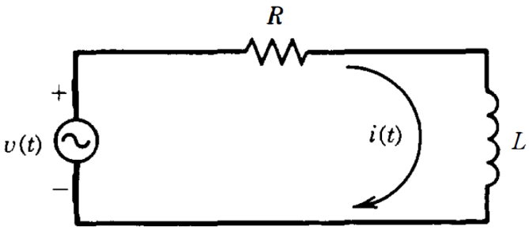
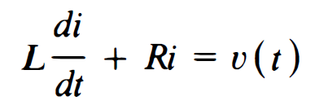



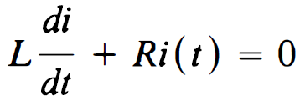
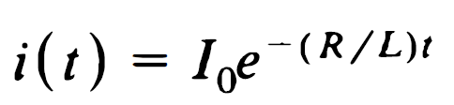
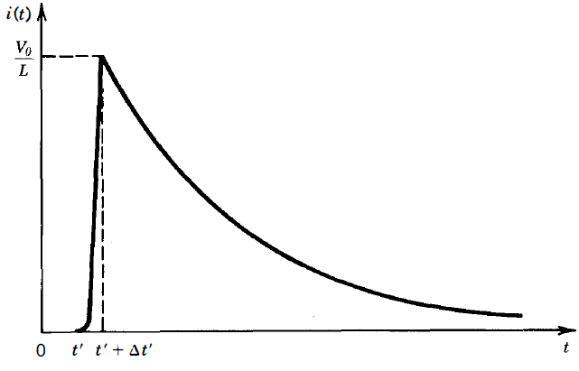

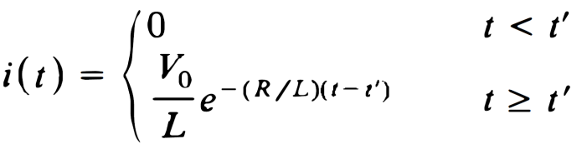
Green's Functions
An Example of Green's function in Circuit Theory:
Inhomogeneous equation with actual source:
Homogeneous equation with impulse source :

Slide 7
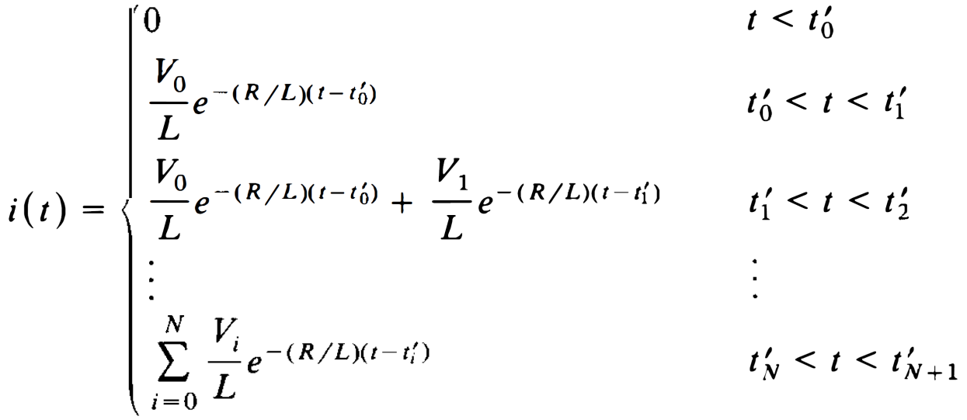
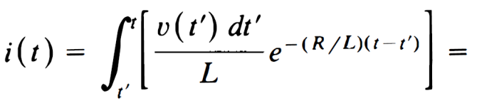
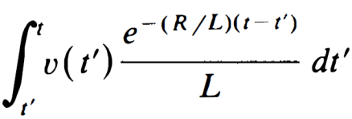


Green's Functions
If the circuit is subjected to N voltage impulses each of duration Δt and amplitude V_{i} (i=0,1,…,N) occurring at t=t_{i}’, then current response can be written as:
If circuit is subjected to a continuous voltage source:
is convolving actual source with Green's function
is response system for impulse

Slide 8
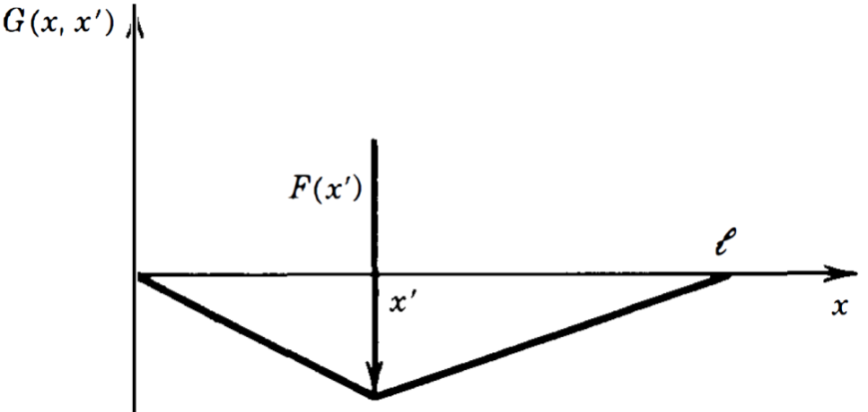



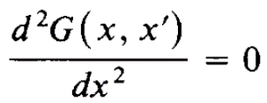
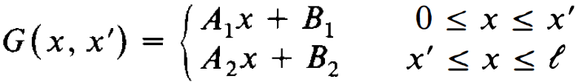

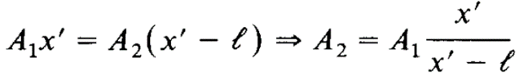
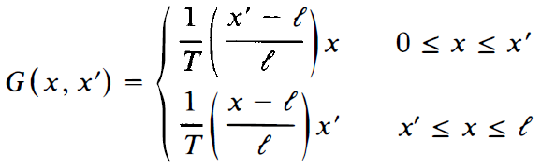


Green's Functions
Another Example of Green's function in mechanics:
Vibrating String is considered.
Away from load at x=x', differential equation reduces to homogeneous form as:
Appling boundary conditions:
At x=x' displacement u(x) of string must be continuous:
Using derivation green’s function

Slide 9


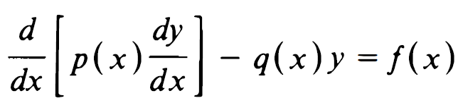
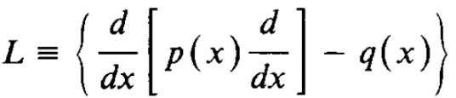

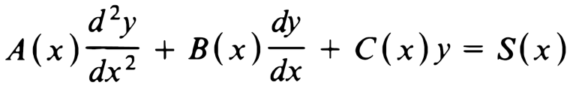

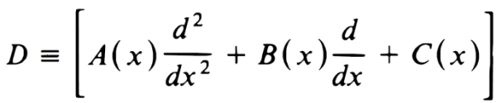
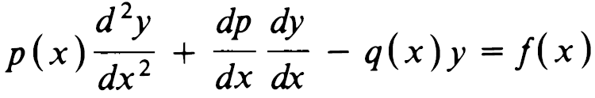
Sturm-Liouville Functions
One-dimensional differential equation named as Sturm-Liouville is written:
L is a operator and λ is a constant
Sturm-Liouville operator is applied for wave equations such as:
scalar wave equation
vector wave equation
Sturm-Liouville equations:
Or:
Every general 1D, source-excited, 2-order PDE can be converted to Sturm-Liouville as:
This can be accomplished by following the procedure as:

Slide 10
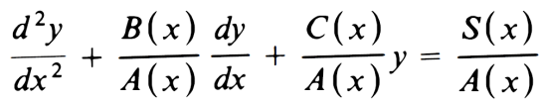
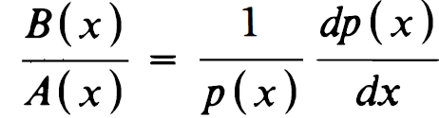
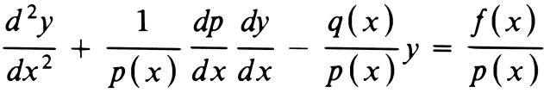
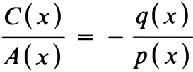
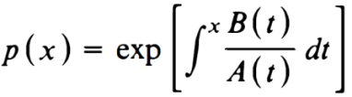
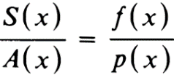

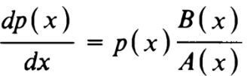

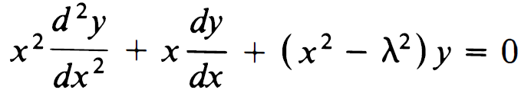
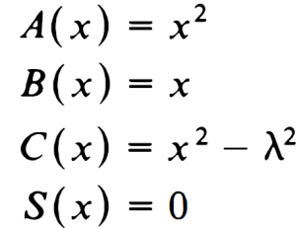
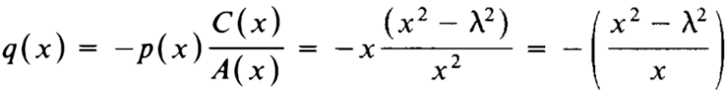


Sturm-Liouville Functions
An Example:
Convert the Bessel differential equation to Sturm-Liouville

Slide 11
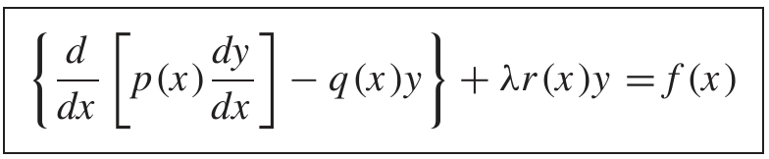



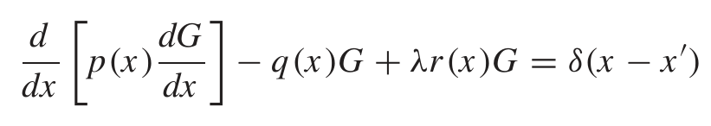

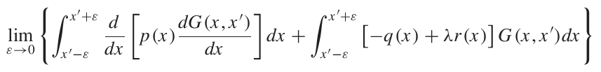

Green's Functions in a Closed Form
A procedure to construct Green’s function of a Sturm-Liouville PDE:
Each general 2-order PDE can be converted to a more generally form of Sturm-Liouville:
Or:
r(x) and f(x) are assumed to be piecewise continuous in region of interest (a≤x≤b) and λ is a parameter to be determined by the nature and boundary of the region of interest.
To obtain Green’s function:
After some mathematical manipulations:

Slide 12


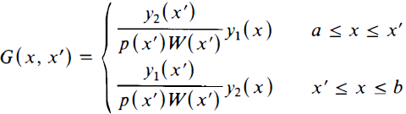

Green's Functions in a Closed Form
Green's Function in Closed Form:
discontinuity at x=x'
Where y1(x) and y2(x) are two independent solutions of homogeneous PDE
Each satisfies boundary conditions at x=a and x=b.
Where:
is Wronskian of y₁ and y₂ at x=x'
Properties of Green's Functions:
  G(x,x') satisfies homogeneous equation except at x=x‘
  G(x,x') is symmetrical with respect to x and x‘
  G(x, x') satisfies certain homogeneous boundary conditions
  G(x, x') is continuous at x=x‘
  dG(x', x')/dx has a discontinuity of l/p(x') at x=x'

Slide 13


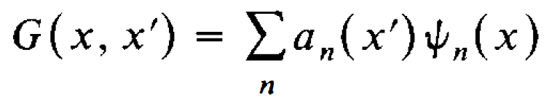
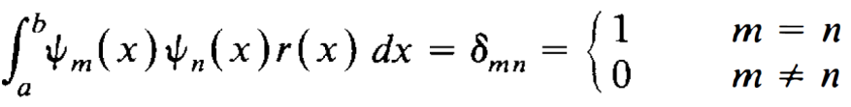
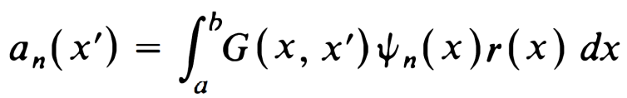

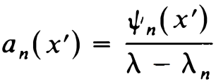
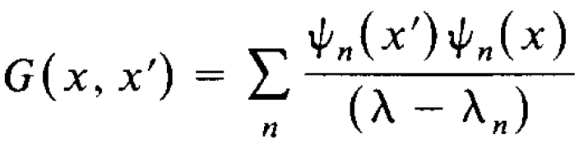
Green's Functions in Series
An alternate procedure for constructing Green's Function:
  By using infinite series of orthonormal functions:
  By using mathematical procedure:

Slide 14

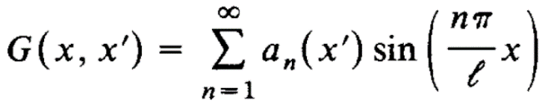
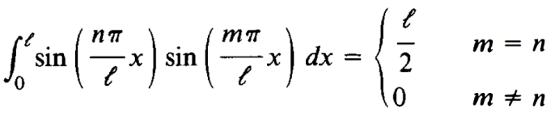
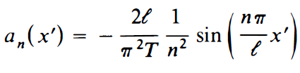

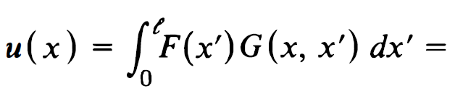
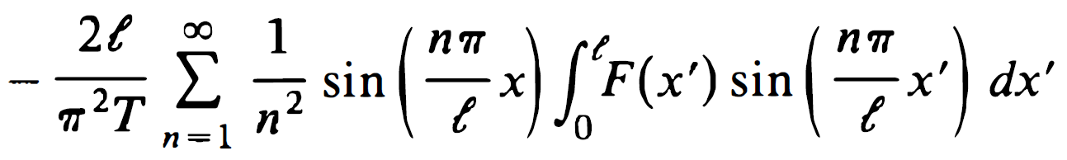
Green's Functions in Series
An Example:
a mechanics problem of vibrating string is considered as:
Since Green's function G(x,x') must vanish at x=0 & l, it is represented as an infinite series of sin(.) function as:
Substituting this eq. into above, and multiplying both sides by sin(m$π$x/$l$):
Orthogonally conditions of sine functions state:

Slide 15
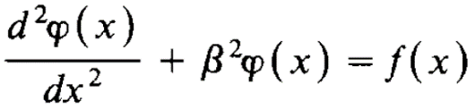



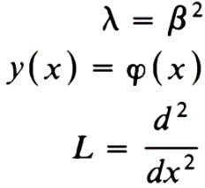
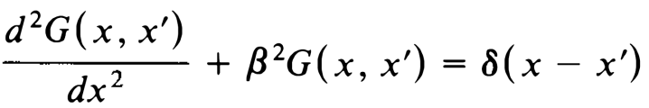
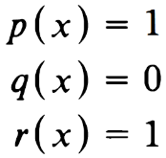
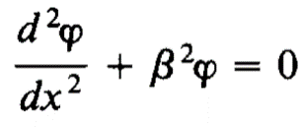
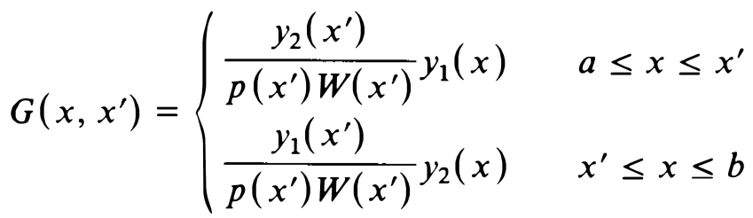



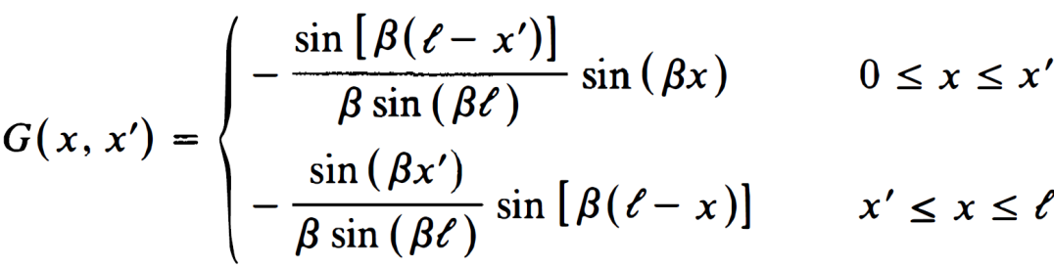



Green's Functions in Series
An Example: A very common differential equation in solutions of transmission line and antenna problems that exhibit rectangular configurations is:
Derive Green's functions in a) Closed form & b) Series form:
Solution:
Differential equation is of the Sturm-Liouville form:
Closed Form Solution using:
vanish
vanish
Two independent solutions:
Singularities:

Slide 16


















Green's Functions in Series
Series Form Solution using:
✓
✓
✓
✓
✓
Applying boundary conditions:
From Orthogonally:
✓
✓
Green's function singularity consists of simple poles as:

Slide 17














Green's Function in Integral Form
In previous sections, Green's function is presented in closed and series forms, when the eigenvalue spectrum, $λ$ is discrete.
In limit the infinite summation of the bilinear formula reduces to an integral.
This form is usually desirable when at least one of the boundary conditions is at infinity.
This would be true when a source placed at the origin is radiating in an unbounded medium.
As a example:
  Green's function of one-dimensional scalar Helmholtz equation is considered as:
Complete set of orthonormal Eigen-functions must satisfy differential equation:
Green's function can be represented by a continuous Fourier integral:
By a mathematical solution:
Which is continuous form of:

Slide 18





Two-Dimensional Green's Functions
A 2D-PDE often encountered in static electromagnetics is Poisson equation.
q(x,y) is electric charge distribution along the structure
Boundary Conditions:
First step is to obtain Green's function as G(x,y ; x',y') and ultimately to obtain potential distribution V(x,y)
✓
as a closed form
✓
as a series form
2D-Green's function as a closed form:
  Above Green's function can be formulated by initially choosing functions that satisfy boundary conditions either along x, or along y direction.
  We begin it’s development by choosing boundary conditions along x direction only.
  This is accomplished by initially representing Green's function by a normalized single function Fourier series of sine functions.

Slide 19








Two-Dimensional Green's Functions
Using:
Multiplying both sides by sin(n$π$x/a), integrating 0<x<a and using:
This equation is a one-dimensional differential equation for g_{m}(y; x',y') which can be solved using tools outlined previous section.
It’s homogeneous form is:
Two solutions that satisfy boundary conditions at y=0,b are:
Using:

Slide 20
















Two-Dimensional Green's Functions
By comparing previous form with the form of:
Using:
and:
Thus Green's function can be written as:
Which is a series summation of sine functions in x' and x, and hyperbolic sine functions in y' and y.

Slide 21














Two-Dimensional Green's Functions
2D-Green's function as a Series form:
Boundary Conditions:
Using method of separation of variables:
Applying Boundary Conditions:
By a similar way:

Slide 22






Two-Dimensional Green's Functions
Eigen-functions must be normalized so that:
Using:
Green's function with $λ$=0 can be written as:

Slide 23













Two-Dimensional Green's Functions
An Example:
  Electric charge is uniformly distributed along an infinitely long conducting wire positioned at $ρ$=$ρ$', φ=φ‘.
  A grounded PEC cylinder of radius $a$ and infinite length is shown in Figure.
  Find series form expressions for Green's function and potential distribution.
  Assume free space within the cylinder.
  A question:
$$δ\left(φ−φ^{′}\right)?$$
  Where is
Orthonormal Eigen-functions:
Boundary Condition:
Using the separation of variables method:
Y_{m} is infinite in origin
B=0

Slide 24















Two-Dimensional Green's Functions
=0
Represents n zeroes of Bessel function
Orthonormal Eigen-functions must be normalized:
Using
Where:

Slide 25













Time-Harmonic Fields
For time-harmonic fields a popular partial differential equation is:
Feed Probe of the cavity
E_{z} is field of a TM^{Z} configuration inside a rectangular metallic cavity:
Green's function is derived as a series form of Eigen-functions:
Using separation of variables and applying boundary conditions:
Eigenvalues of system are:

Slide 26








Time-Harmonic Fields
Using Orthogonally of Eigen-functions:
Using:
Green's function possesses a singularity:

Slide 27









Green's Functions of Scalar 3D-Helmholtz Equation
Rectangular Coordinates
Excited by linear electric probe
(1)
(2)
Substituting (2) into (1):
Multiplying both sides of above eq. by sin(p$π$x/a).cos(q$π$y/b):

Slide 28













Green's Functions of Scalar 3D-Helmholtz Equation
Function g_{mn}(z,x',y',z') satisfies single variable differential equation:
We can write the wronskian as:
Using:
Sturm-Liouville operator
Or:

Slide 29











Green's Functions of Scalar 2D-Helmholtz Equation
Cylindrical Coordinates:
An infinite electric line source of constant current I_{z} is Placed at$ρ$=$ρ$', $φ$=$φ$' inside a circular waveguide.
(1)
Green's function by an infinite Fourier series whose eigenvalues:
(2)
Substituting (2) into (1):
Multiplying both sides by and integrating 0 to 2$π$and using:
This equation is a one dimensional differential equation for g_{m}.
its solution can be obtained using the closed form of the Green’s functions.

Slide 30


















Green's Functions of Scalar 2D-Helmholtz Equation
Homogeneous Bessel's differential equation:
Y_{m} is singular at $ρ=0$
Using:
Sturm-Liouv.
Boundary Condition:
Using Wronskian:

Slide 31






















Green's Functions of Scalar 2D-Helmholtz Equation
An Example:
An infinite electric line source of constant current I_{z} is located at $ρ$=$ρ$', $φ$=$φ$' and is radiating in an unbounded free-space medium.
This is like to previous problem but its medium is unbounded.
singular
singular
Using addition theorem for Hankel functions:

Slide 32















Green's Functions of Scalar 3D-Helmholtz Equation
Spherical Coordinates:
Green's function of a source positioned at r',$φ$',$θ$' inside a sphere with free-space:
Green's function can be represented by a double summation of an infinite series as:
Tesseral Harmonics
Multiplying by r² and then substituting in differential equation:
Dividing both sides by:
Using CH3

Slide 33

















Green's Functions of Scalar 3D-Helmholtz Equation
Using CH3:
or
(1)
Using:
Orthogonally conditions:
Multiplying both sides of (1) by and integrating $θ and φ$:
Using:
This is a differential equation and its solution can be obtained using the closed form:
Using one-dimensional Sturm-Liouville form:
Using Boundary Condition:

Slide 34














Green's Functions of Scalar 3D-Helmholtz Equation
Using the Wronskian for spherical Bessel functions:

Slide 35




Dyadic Green's Functions
Green's function development of previous sections can be used for solution of electromagnetic problems that satisfy scalar wave equation.
Most general Green's function development and electromagnetic field solution, for problems that satisfy the vector wave equation, will be to use vectors and dyadic.
Defining dyadic:
A, B are vectors
A dyadic D can be defined by the sum of N dyads:
General Form of Differential Operator:
It should be noted here that solution cannot be represented by:
Solution by Green's Functions:

Slide 36
Dyadic Green's Functions
Dyadic Green 'S Functions:

